Slide 1
SIEM Overview
Module 1

Slide 2
Module Objectives
Upon completion of this module, you will be able to:
  Define what a SIEM is and how it can be utilized to meet a wide range of requirements.
  Describe and identify appliance types that make up the McAfee SIEM solution.
  Describe and identify the McAfee SIEM solution component architecture.
  Effectively size a McAfee SIEM solution by calculating the proper Events Per Second rate and log storage requirements.

Slide 3

Module Topics
  What is SIEM
  How a SIEM is used
  McAfee SIEM Architecture and Components
  Deployment Scenarios and Sizing

Slide 4
What is SIEM?
Security Information and Event Management (SIEM)
  A complex collection of technologies designed to provide vision and clarity within an IT Infrastructure
    Event Analysis and Workflows
    Event Aggregation
    Event Normalization
    Event Correlation
    Log Management and Retention
  The Evolution and Integration of Two Distinct Technologies
    Security Information Management (SIM)
    Security Event Management (SEM)
Notes:
Security Information and Event Management (SIEM)
Sometimes defined as the collection of technologies designed to provide a holistic view of an organizations IT Infrastructure.
Event Analysis and Workflow
One of SIEM technology’s main goals is to reduce the signal to noise ratio by surfacing the most critical threats or events. Many IT infrastructures can generate hundreds of thousands of normal activity related events in a very short period of time and it is the SIEMs function to separate normal activity events from abnormal or malicious activity. This functionality provides a security analyst with a simplified view of what is important and what investigation activities should be prioritized.
Event Aggregation
Aggregation is the process in which a SIEM collects and consolidates identical events into a single summary event. This consolidated event should still provide a security analyst with the necessary information to process the event activity effectively. The term log aggregation is also sometimes used to describe the process in which events from multiple devices and locations are collected and aggregated to a centralized location.
Event Normalization
Event normalization is the process in which a SIEM classifies or categorizes events in to related types and sub-types. An example of this is a windows login event and a Linux SSH login event. The McAfee SIEM will classify both of these events as an authentication type event.
Continued on next page

Slide 5
Hidden
Notes:
Event Correlation
Event correlation is the process in which a SIEM relates a series of events based upon a logical relationship to generate an incident or more meaningful event.
Log Management and Retention
The SIEM process typically provides log storage, organization, retrieval, and archival services to satisfy any log management requirements that an organization may have.
Security Information Management
Primarily focused on the enrichment, normalization, and correlation of security events.
Security Event Management
Primarily focused on collecting and aggregating security events

Slide 6
How SIEM is used
SIEM is used by Security Professionals and Analysts to:
    Meet Compliance Obligations
    Meet Log Retention Mandates
    Monitor, Document and Respond to Security Incidents and Threats
    Improve Security Operational Efficiency and Visibility
SIEM can also aid in Identifying more elusive security events:
    Policy Violations
    Detection of focused and stealthy attacks
SIEM as a Operations Tool can be used to detect devices, appliances, systems, servers, workstations, and applications that are:
    Unpatched
    Misconfigured
    Malfunctioning
Notes:
Compliance Obligations
One of the main driving forces in the implementation of SIEM is the relatively recent governmental and industrial regulatory compliance requirements for organizations. Many organizations fail to effectively protect sensitive information appropriately which can cause losses or damages to customers, individuals, and other organizations. In an effort to reduce losses and to protect innocent victims government organizations and industry leaders have imposed standards of compliance, along with potentially severe penalties for failure to comply. Not only must organizations comply with these numerous and new security requirements, but they also have to show evidence of their compliance, which typically requires self-auditing, monitoring, and reporting.
Elusive Security Events
Many events are so subtle or are obscured by thousands of events per second that without the aid SIEM would go completely unnoticed. These more elusive security events include violations of policy, unauthorized access attempts, and those of the highly skilled and focused attacker.

Slide 7
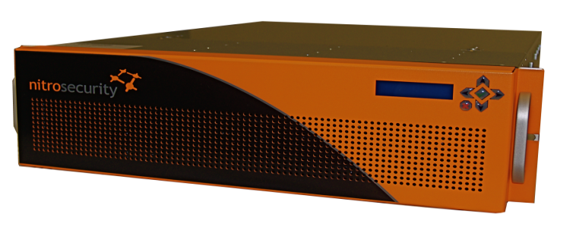
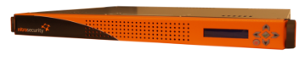
















McAfee SIEM Components Overview
“Single-Pane-of-Glass”
Highly Customizable Browser Based UI
ESM
ELM
Receiver
Unified Visibility & Analysis
Compliance & Reporting
Policy Management
Log Management
Compliant Log Storage
SAN/CIFS/NFS/Local Storage
3rd Party Log/Event Collection
Network Flow Data Collection
VMware Receivers Available
ADM
DEM
ACE
Application Data Monitor
Layer 7 Decode
Full Meta-Data Collection
Database Activity Monitor
Database Log Generation
Session Audit
Advanced Correlation
Risk-Based Correlation
Historical Correlation
Application Visibility
100s of applications and
500+ document types
Data Visibility
Data traffic from leading databases
Risk Scoring
Advanced Threat Detection
Asset information/context
Which assets are most at-risk
Historical data analysis for new and emerging threats
Notes:
The McAfee SIEM is an appliance based solution consisting of many different components and options. These additional components provide a security analyst with a more in-depth or holistic view of their environment with additional context and content visibility associated with standard events being generated and collected.
ESM
The McAfee Enterprise Security Manager (ESM) is the central point of administration for data, settings, and configuration. Using an ESM allows network administrators to keep all configuration settings, user and access group profiles, and event and flow data in a single location. The ESM can be involved in communication with multiple devices simultaneously.
ELM
The McAfee Enterprise Log Manager (ELM) collects logs intelligently, storing the right logs for compliance, and parsing and analyzing those logs for security. The ELM retains logs in their original format for as long as required for specific compliance needs. The ELM will not alter original log entries or files to ensure compliance with chain of custody and non-repudiation efforts.
RCV
The McAfee Event Receiver enables the collection of security events and network flow data from multi-vendor sources including firewalls, virtual private networks (VPNs), routers, NetFlow, sFlow, and others. The Receiver is an integral component of a comprehensive security management solution with the ability to gather and analyze data from third-party network and security solutions. The Receiver allows for the collection of this data and normalizes it into a single manageable solution. This provides the user a single view across devices from multiple vendors, such as Cisco, Check Point, Juniper, and McAfee.
Continued on next page

Slide 8
Hidden
Notes:
ADM
The McAfee Application Data Monitor (ADM) appliance decodes an entire application session to Layer 7, providing a full analysis of everything from the underlying protocols and session integrity all the way up to the contents of the application (such as the text of an email or its attachments). This level of detail allows accurate analysis of real application use, while also enabling you to enforce application use policies and detect malicious, covert traffic.
DEM
The McAfee Database Event Monitor (DEM) consolidates database activity into a central audit repository and provides normalization, correlation, analysis, and reporting of that activity. It normalizes activity for analysis with other pertinent security information for expanded visibility into user and data interactions, user information, application contents, OS activity, vulnerabilities, and even network location.
ACE
The McAfee Advanced Correlation Engine (ACE) supplements McAfee Enterprise Security Manager event correlation with a risk detection engine that generates a risk score using rule-less risk score correlation, and a threat detection engine that detects threats using traditional rule-based event correlation. Identify an asset (users or groups, applications, specific servers, or subnets) and Advanced Correlation Engine alerts you if the asset is threatened. Audit trails and historical replays support forensics, compliance, and rule tuning.

Slide 9

McAfee SIEM Architecture – “Combo Boxes”
ESM
Receiver
Combo boxes provide McAfee ESM and Receiver functionality in a single appliance
ELM
CIFSNFS
SAN
ELM Storage
Two Basic Types of Combo Boxes:
    ESM and Receiver (ESMREC)
      1U appliance rated at 1K EPS with 1 TB local storage
      3U appliance rated at 5K EPS with 2.5 TB local storage
    ESM, Receiver and ELM (ESMRECELM)
      EPS rated at 1K, 2.5K or 5K
      Storage from 1TB to 3.75TB local storage
Limiting Factors
    Cannot manage any additional receivers
    Can manage 1 ACE and any combination of 3 ADM and DEM devices
    ELM storage must be off-box SAN, NFS or CIFS storage
Recommended solution for small to mid-size implementations
Notes:
The McAfee ESM with Event Receiver functionality, referred to as an ESM/Event Receiver Combo (ESMREC), has a local Event Receiver built in.
The McAfee ESM with Event Receiver and Log Management functionality, referred to as an ESM/Event Receiver/ELM Combo (ESMRECELM), has a local Event Receiver and ELM built in.
These combo boxes possess the same functionality as an ESM with the following exceptions:
Cannot manage any additional receivers
Can manage 1 ACE and any combination of 3 ADM and DEM devices
ELM storage must be off-box SAN, NFS or CIFS storage

Slide 10
McAfee SIEM Architecture – ESM
AES Encrypted Channel
Receiver
ELM
CIFSNFS
SAN
ESM
ELM Storage
Receiver
AES Encrypted Channel
ERC-5250
    50,000 EPS
    8 TB storage
ETM-6000
    70,000 EPS
    14 TB storage
ETM-X4
    150,000 EPS
    14 TB + 800 GB SSD
ETM-X6
    300,000 EPS
    14 TB + 3.2 TB Flash
Standalone ESM
    Manages Multiple Receivers, Receiver-ELMs, ADMs, DEMs, and ACEs
    Local Storage can be extended with a DAS device (10, 20, or 50 TBs)
    Scales from small-mid sized implantations all the way up to global enterprise environments
    Communication with all devices via encrypted control channels
Distributed ESM
    Manage up to 100 distributed ESMs
    Pulls data from child ESMs based on filters
    Seamlessly drill down to child ESM data
Notes:
All device settings are managed via the ESMI and are pushed from the ESM. The ESM functions as a virtual data warehouse, aggregating all event and flow data retrieved from the devices. A robust reporting and analysis suite is provided. The ESM makes managing all these aspects of network security easier than ever before, allowing system administrators to access and manage the McAfee solution from anywhere in the world.

Slide 11
McAfee SIEM Architecture – Receiver
AES Encrypted Channel
Receiver
ELM
CIFSNFS
SAN
ESM
ELM Storage
Receiver
AES Encrypted Channel
ERC-1250
    5,000 EPS
    1 TB storage
ERC-2600
    10,000 EPS
    1.8 TB storage
ERC-3450
    15,000 EPS
    1.8 Storage
ERC-4600
    20,000 EPS
    6 TB Storage
McAfee Receiver
    Supports 100’s of third-party log sources
    High Availability Deployment Option
    Supports generating and capturing of network flows from a SPAN or TAP
    Supports correlation engine functionality
    Scales from small-mid sized implantations all the way up to global enterprise environments
    Communication with all devices via AES encrypted control channels
Two configurations
    Standalone Receiver
    Receiver-ELM Combo
Notes:
The McAfee Event Receiver enables the collection of security events and network flow data from multi-vendor sources including firewalls, virtual private networks (VPNs), routers, Nitro IPS/IDS, NetFlow, sFlow, and others. The Receiver is an integral component of a comprehensive security management solution with the ability to gather and analyze data from third-party network and security solutions. The Receiver allows for the collection of this data and normalizes it into a single manageable solution. This provides the user a single view across devices from multiple vendors, such as Cisco, Check Point, Juniper, and McAfee and allows event and flow data collection from Nitro IPS devices and routers that send data feeds to the Receiver.

Slide 12
McAfee SIEM Architecture - DEM
ESM
AES Encrypted Channel
DEM
Database network traffic via SPAN port
Database Event Monitor (DEM)
    Monitors database network traffic via SPAN or Network Tap.
      No impact on database, no need to change audit levels on database
    Optional host agents with low system impact
    EPS rated appliances 5K, 10K, 15K.
    Auto discover database instances
      Detect unauthorized or rouge databases
    Complete audit trail
      Captures all transactions from login to logoff
      Includes all session queries and commands
    Fully integrated with the McAfee ESM
      Correlate Database Events with other systems and network device events
      Reports directly to the McAfee ESM via AES Encrypted Channel
Notes:
A Database Event Monitor (DEM) acts much like an Intrusion Detection System (IDS) for databases. If activity seen on the network (by the DEM appliance) or on a database server (by the DEM agent) matches a known pattern that indicates malicious data access, an alert is generated. In addition, all transactions are logged, for use in compliance.
A SIEM collects, correlates, and analyzes events. By providing database-triggered events and activity to a SIEM, it becomes much easier to track other security events and anomalies to real instances of data loss or theft. By integrating the two, the benefits of deploying both a DEM and a SIEM are realized, with much lower capital and operational expense. In addition, the common management of DEM devices, agents, and policies lowers operational costs even further.
Also, because database monitoring rules can be managed, edited, and adjusted from the same interface that provides analysis and reporting, it becomes much easier to adjust specific database monitoring profiles (which rules are enforced, what transactions are logged, etc.), reducing false-positives and improving security overall. Each DEM device the ESM manages can be configured with its own policy; connection; event, flow, and log retrieval settings; sensitive data masks; identifier management; and database servers.

Slide 13




McAfee SIEM Architecture - ADM
ESM
AES Encrypted Channel
ADM
eMail@
chat
Layer 7 Application Monitoring via SPAN
http://
P2P
Application Data Monitor (ADM)
    Monitors application (Layer 7) traffic via SPAN or Network Tap
      No effective on Application Performance or Latency
    Supports 100+ application protocols and 500+ document types.
      Pre-built detection rules for regulated and sensitive data types
      Full session data capture and visibility into all application traffic
    Supports user-definable dictionaries and custom rules
    Creates full audit trail of application events
    Detection of advanced application layer threats and Application Anomalies
    Fully integrated with McAfee ESM
      Correlate Application Events with other systems and network device events
      Reports directly to the McAfee ESM via AES Encrypted Channel
    Throughput rated at 500 Mbps or 1 Gbps
Notes:
The ADM can generate the following types of event:
Meta Data: One meta data event is generated for each transaction taking place on the network and includes details such as addresses, protocol, file type, file name. There will be a huge number of meta data events and they will be placed in the query table. The events in the query table will be grouped via the session table, for example if 3 files are transferred in one FTP session they will be grouped together.
Protocol Anomaly: Protocol anomalies are hard coded into the protocol modules and include events such as a TCP packet being too short to contain a valid header and an SMTP server returning an invalid response code. Protocol anomaly events should be rare and will be placed in the event table.
Rule Trigger: Rule trigger events are generated by rule expressions detecting anomalies in the meta data generated by the ICEengine and could include anomalies such as a protocol being used outside of normal hours or an SMTP server unexpectedly talking FTP. Rule trigger events should be rare and will be placed in the event table.
The event table contains one record for each detected protocol anomaly or rule trigger event. The event records link to the session and query tables via the session id where more detail about the network transfers (meta data events) that triggered the event is available. Each event also links to the packet table where the raw packet data for the packet that triggered the event is available.
The session table contains one record for each group of related transfers that take place on the network (group of FTP file transfers on same session, etc.). The session records link to the query table via the session id where more details about the individual network transfers (meta data events) are found. In addition, if a transfer within the session causes a protocol anomaly or triggers a rule then there is a link to the event table.
Continued on next page

Slide 14
Hidden
Notes:
The query table contains one record for each meta data event (content transfers that takes place on the network). The query records link to the session table via the session id. If the network transfer represented by the record triggers a protocol anomaly or rule then there is a link to the event table. In addition there is a link to the packet table via the text field where a textual representation of the full protocol/content stack is found.
Each ADM device the ESM manages can be configured with its own policy; connection; event, flow, and log retrieval settings; sensitive data masks; identifier management; and database servers.

Slide 15
McAfee SIEM Architecture - ACE
ESM
AES Encrypted Channel
ACE
Advanced Correlation Engine (ACE)
    Dedicated Correlation Appliance supplementing the ESM’s existing correlation capabilities
    Deployed in either Real-Time or Historical Modes
    Simultaneous “rule-based” and “rule-less” correlation
    Correlates data from any supported data source
    Correlates data across distributed networks
Dedicated rules-based correlation engine
    Includes hundreds of predefined event correlation rules
RSC (Risk Scoring Correlation)
    Calculates and tracks a quantitative risk score
    Custom risk scoring based on what is important to your organization
Historical Correlation
    Replay historical logs and events against both rules and RSC engines
Notes:
McAfee ACE is a dedicated appliance that can be deployed alongside the ESM to provide dedicated correlation logic that supplements the ESM's existing event correlation capabilities. It can be deployed in either real-time or historical modes. When operating in real-time mode, events are analyzed as they are collected for immediate threat and risk detection. In historical mode, any available data collected by the ESMI can be “replayed” through either or both correlation engines, for historical threat and risk detection. That means that when new zero-day attacks are discovered, the ESMI can look back to determine whether or not the organization was exposed to that attack in the past, for “sub zero day” threat detection.
ACE appliances supplement the ESM's existing event correlation capabilities by providing two dedicated correlation engines:
Risk Correlation - A risk detection engine that generates a risk score using rule-less correlation. While rule-based correlation is a necessary and valuable feature of any SIEM, these systems can only detect known threat patterns, requiring constant signature tuning and updates to be effective. The answer is to supplement traditional event correlation with rule-less correlation technology. In rule-less correlation systems, detection signatures are replaced with a simple, one-time configuration: simply tell the Risk Correlation engine what is important to your business. It could be a particular service or application, a group of users, or specific types of data. Risk Correlation then starts to track all activity related to those items, building a dynamic risk score that raises or lowers based upon real-time activity. When a risk score exceeds a certain threshold, an event is generated within the ESMI. This event can be used to alert you to growing threat conditions, or it can be used by the traditional rule-based correlation engine as a condition of a larger incident. The ESMI keeps a complete audit trail of risk scores to allow full analysis and investigations of threat conditions over time.
Continued on next page

Slide 16
Hidden
Notes:
Correlation - A threat detection engine that detects threats using a traditional rule-based event correlation. Rule-based correlation uses traditional correlation logic to analyze collected information in real-time. All logs, events, and network flows are correlated together—along with contextual information such as identity, roles, vulnerabilities, and more—to detect patterns indicative of a larger threat. While network-wide, rule-based correlation is already supported directly on all Event Receiver appliances, the ACE appliance complements this existing capability and provides a dedicated processing resource to correlate even larger volumes of data, either supplementing existing correlation reports, or off-loading them completely.
Each ACE device the ESM manages can be configured with its own policy; connection; event and log retrieval settings; and risk managers.

Slide 17
McAfee SIEM Architecture Overview
McAfee Enterprise Security Manager
Content-Aware SIEM
McAfee Receiver
3rd Party Log/Event/Flow Collection and Correlation Engine
Receiver
Receiver
Receiver
ESM
AES Encrypted Channel
ELM
CIFSNFS
SAN
McAfee Enterprise Log Manager
Fully integrated Compliant Log Management
ACE
McAfee Advanced Correlation Engine
RSC, Rule, and Historical Correlation
AES Encrypted Channel
DEM
McAfee Database Monitor
Database Activity Monitoring
ADM
McAfee Application Data Monitor
Content Visibility
Notes:
The McAfee SIEM Architecture provides a high-performance, powerful security information and event management (SIEM) solution. This architecture brings event, threat, and risk data together to provide strong security intelligence, rapid incident response, seamless log management, and extensible compliance reporting. At the core of our SIEM offering, Enterprise Security Manager consolidates, correlates, assesses, and prioritizes security events for both third-party and McAfee solutions.

Slide 18
McAfee SIEM Architecture Overview
McAfee ESM
McAfee Receiver
ESMi Desktop (User Interface)
Central Management
Policy Management
Reporting
Alarms
Queries
Workflow
Data Source Collector
Parses Logs according
to Policy
Event Normalization
Event Aggregation
Hosts Correlation Engine
Forwards Logs to ELM
Pull Events
from RCV
Event
Database
Central Database
Push Events
to Correlation
McAfee Correlation
Local or Global Correlation
Relates Events to Generate
Incidents
Data Sources
100’s of Third Party Data Sources supported
Syslog
Netflow
CEF
WMI
Databases
Custom Retrievals
Pull or Push
Events and
Logs
Push Logs to ELM
McAfee ELM
Log Management
Full Text Indexing
Compressed Storage
Definable Storage Pools
Definable Retention Periods
Data Integrity Checks
Logs
Notes:
The ESMi acts to pull events from the Receiver…the Receiver never pushes events to the ESM. In contrast, the data sources can pull or push events to the Receiver. It is the responsibility of the Receiver to push events to the ELM.

Slide 19
Deployment Scenario Distributed (Large)
Main Central Site
Internet
ESM
ELM
Logs
Correlation
Receiver
Receiver
Remote Site
Local Data Sources
Receiver
Restricted Network
Servers
Network
Hosts
Servers
Databases
Local Data Sources
DMZ
Servers
Network
Hosts
Servers
Databases
Notes:
This slide depicts the behavior of the components typically for a large or distributed scenario. In this case, one Receiver is located at a remote location. The ESM located in a central location will pull events from this Receiver at regular intervals.

Slide 20
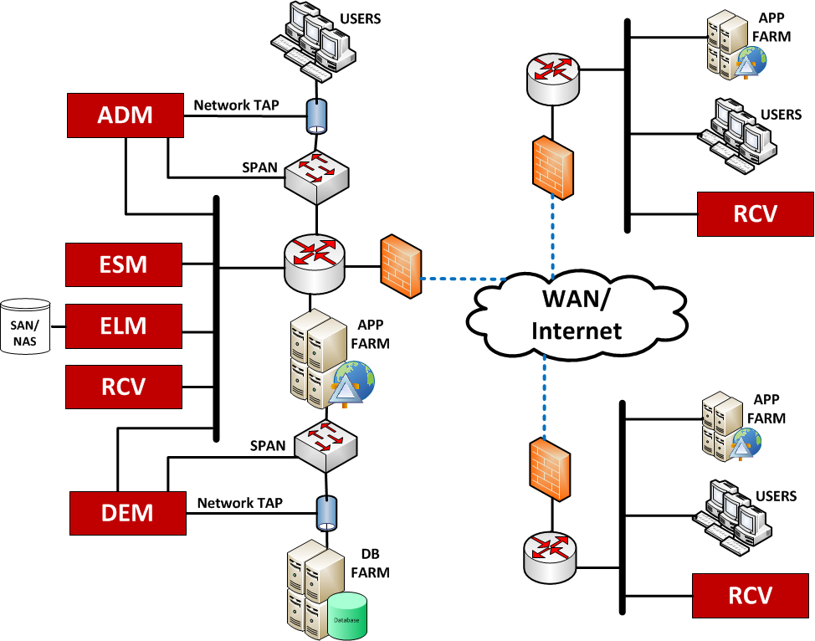
Large Centralized Deployment Example
Notes:
One example of a large network deployment involves two remote sites, each with a remote Receiver. The central location might house other components, such as the ELM, ADM or DEM.

Slide 21
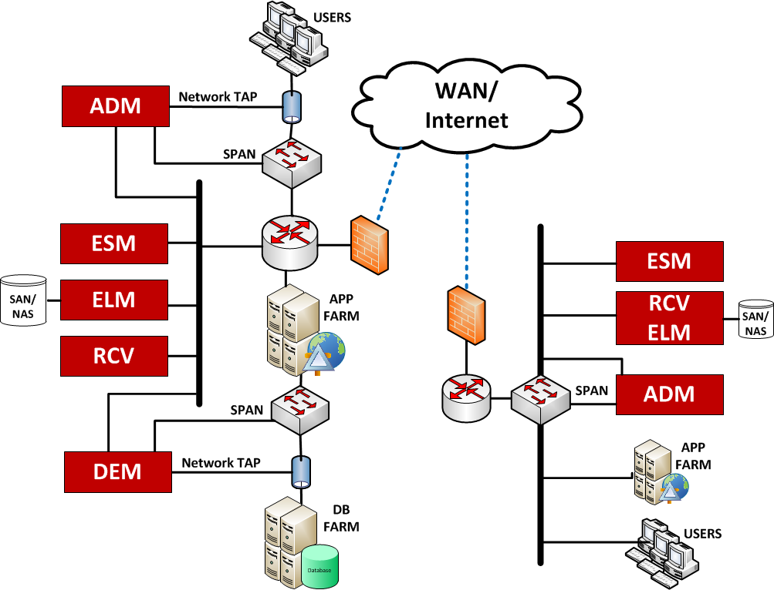
Large Distributed Deployment Example
Notes:
A distributed network might include other components at the remote site, such as the ADM or even another ESM. SPAN ports or network TAPs are used for the ADM and DEM.

Slide 22
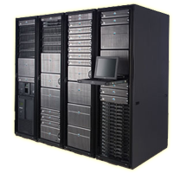

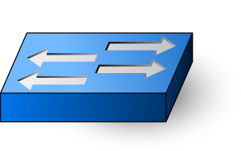

Deployment Scenario (Small)
McAfee ESM Combo (All-In-One)
ESMi Desktop
Receiver
Correlation
ELM
Central Database
Logs
McAfee Correlation
Relates Events to Generate Incidents
Network Flows
Security Events
Windows WMI
Syslog
Databases
Applications
Notes:
For smaller deployments, an all-in-one or Combo Box may be employed. In such a case, the ESM, Receiver, Correlation Engine and ELM are all located on one appliance.

Slide 23
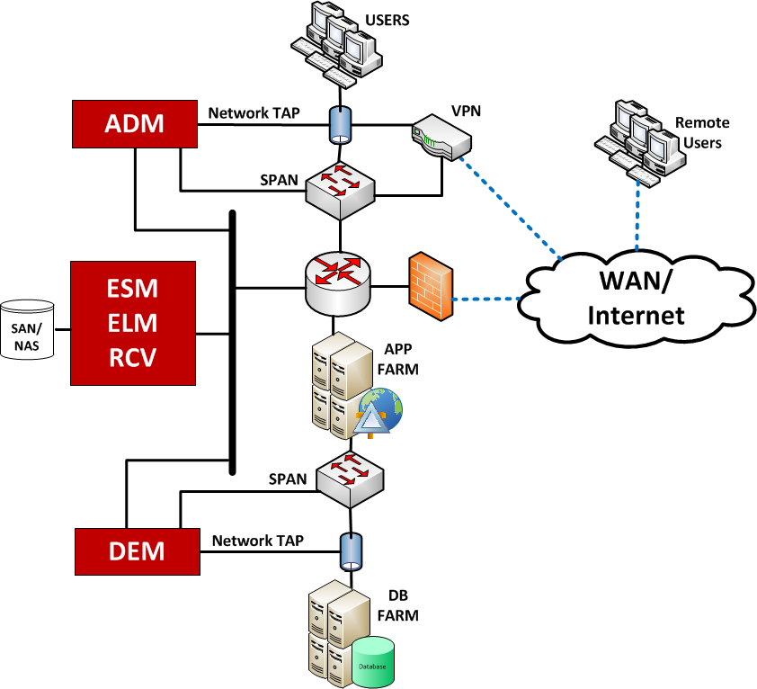
Small Deployment Example
Notes:
A small deployment might include other components, such as a DEM or ADM, still located at the same location as a combo box, for example. Size considerations must be made, however, to ensure deployments fit a particular enterprise’s needs most effectively.

Slide 24
McAfee SIEM Sizing Overview
Combo boxes (ESMREC and ESMRECELM)
    EPS rate is under 5K EPS
    No projected growth that requiring additional receivers
    Entry point for an SMB.
Receiver-ELM (RECELM) combos
    EPS rate exceeds 5K EPS
    ELM is required but a standalone box is not necessary
    Receiver EPS rate will not exceed 10K EPS
    Multiple Receivers to include VM receivers
    ADM and DEM devices deployed
Distributed Architecture (All standalone Devices)
    Large enterprise
    Multiple collection points
    Organization is projecting significant growth of data sources
    Requirement for full text indexing for fast data searches
    Global operations requiring options for failover and redundancy
Notes:
The McAfee SIEM architecture can be customized to fit with a wide range of scenarios and sizing ranges from the SMB environments all the way up to the international enterprises and government organizations supporting hundreds of thousands of devices. Some sizing considerations are listed here for a quick reference.

Slide 25
General EPS Calculations
Events Per Second (EPS)
    EPS = (total number of events)/(time period in seconds)
Example EPS Calculation
    A firewall produces 10,000 log events in a 60 minute period
    EPS = (10,000)/(60*60) = (10,000)/(3600) = 2.777 EPS or 3 EPS
EPS rates are often lower than assumed
    20,000 EPS Receiver can handle (20,000)*(86,400) events per day
      1,728,000,000 events per day
How to collect these values?
    Use existing data source consoles
    Setup temporary syslog capture from the busiest data sources
    Use data collected from an evaluation
    Be creative, unfortunately in logging one-size doesn’t fit all.
    Based on traffic levels, users, device size and positioning and purpose
Notes:
Sizing the McAfee SIEM solution depends upon the basic understanding of Events Per Second. This calculation is used in sizing all McAfee SIEM solution components and is often misunderstood.

Slide 26
ESM EPS Calculations
ESM utilizes aggregation to reduce event storage requirements while maintaining full visibility of all data
    Aggregation is the grouping of events with common fields that occur repetitively in a specified time window
    10:1 aggregation can be assumed for most implantations
      This number will vary as data sources firewalls aggregate at a much higher rate than a Unix server
    For smaller and/or unique architectures assume 5:1 aggregation overall
Example EPS calculation
    Assuming 3 receivers (10K EPS), and one DEM (5K EPS).
    Total Un-aggregated EPS of 35,000
    With 10:1 aggregation
      (35,000/10) = 3,500 EPS
    With 5:1 aggregation
      (35,000/5) = 7,000 EPS
    Smallest McAfee standalone SIEM handles 50,000 EPS providing sufficient capacity and room for growth
Notes:
Aggregation is an important aspect to an optimized SIEM solution and must be understood to properly calculate the McAfee ESM sizing requirements.

Slide 27
ELM Sizing and Storage
ELM devices store raw log records and not aggregated events
    EPS refers to DB insert rates not raw log records
    The ELM EDB is often referred to as the ELM Management Database
      Contains indexes and pointers to the ELM file system where the logs are stored
ELM Compression is 14:1 (default), 17:1 or 20:1
    Note that Higher compression ratios affect search time
Example storage calculation
    EPS rate is 15K EPS
      15,000 * 86,400 = 1,296,000,000 raw events per day
    Desired retention period is 1 year
      365 * 1,296,000,000 = 473,040,000,000 events per year
    Assume an average event size of 300 bytes
      473,040,000,000 * 300 = 129 TB
    Compression at 15:1 = 8.6 TB required storage
    Compression at 17:1 = 7.5 TB required storage
    Compression at 20:1 = 6.4 TB required storage
Notes:
When sizing the McAfee log management solution (ELM) EPS rates must be converted to raw log sizes and also take into account compression settings.

Slide 28
  SIEM is the evolution and integration of which two distinct technologies?
Log Management
Security Information Management
Security Incident Management
Security Event Management
Security Equipment Management
Notes:
Correct Answer: Security Information Management and Security Information Management

Slide 29
The McAfee ESM and Receiver “Combo Box” can manage multiple receivers and any combination of DEMs and ADMs?
True
False
Notes:
False: The “Combo Box” cannot manage any additional receivers and can manage 1 ACE with any combination of 3 ADM and DEM device.

Slide 30
Check Your Understanding
The following event and network flow statistics were gathered from your network over a twelve (12) hour period of time:
    Firewall produced 950,000 Total Events
    Unix Servers produced 44,000 Total Events
    Web Applications produced 1,400,000 Total Events
    Routers produced 110,000,000 Total Flows
Answer the following questions using these statistics:
  For each set of devices what is the EPS?
  What is the total network EPS?
  Can a McAfee “Combo Box” handle this load?
Notes:
Answers:
Firewall (21 EPS), Unix Servers (1 EPS), Web Apps (32 EPS), and Routers (2,546 EPS/FPS)
Total 2,600 EPS
The largest “Combo Box” can handle 5,000 EPS and would handle this environment.

Slide 31
Hands-on Practice
Refer to the Practice Manual
Practice 1: ESM Walk-Through

